Slide 1
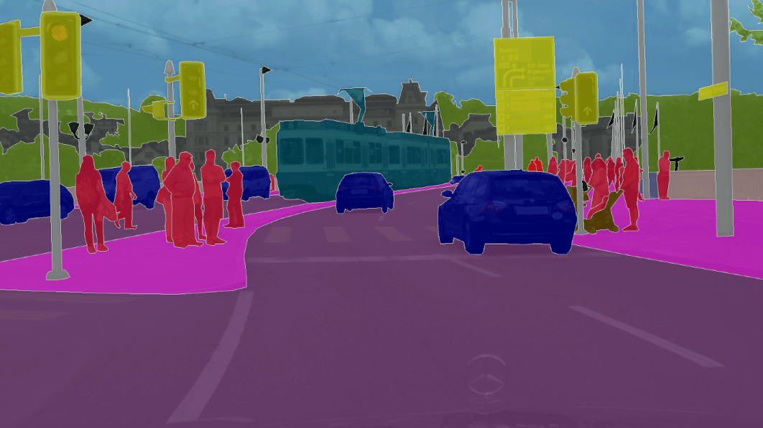
Semantic Segmentation
Student: Zoltan Szekely
Mentors: Alexandru Căliman
Andras Iani

Slide 2
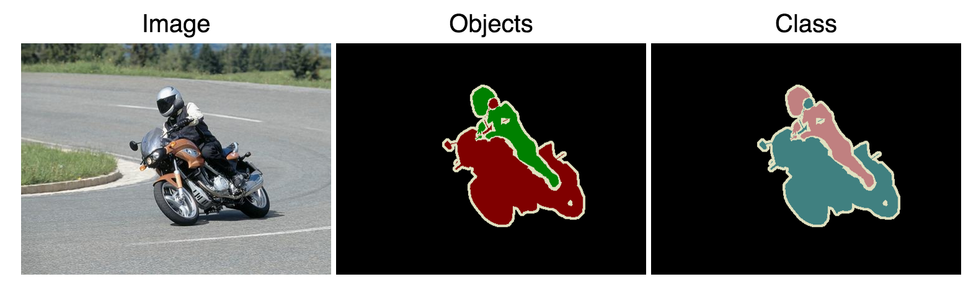
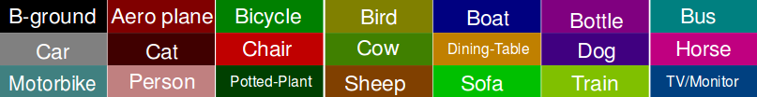
Dataset used:
● Pascal VOC 2012
● Color palette:

Slide 3
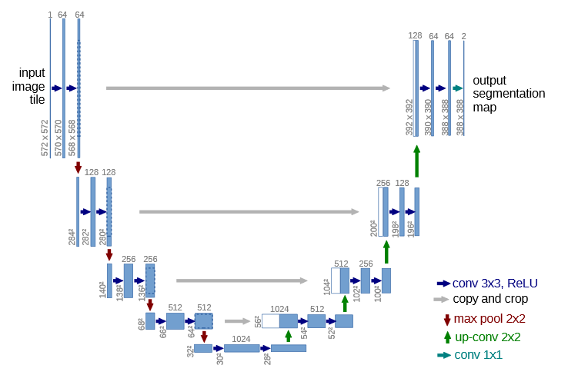
Model used:
● U-Net

Slide 4
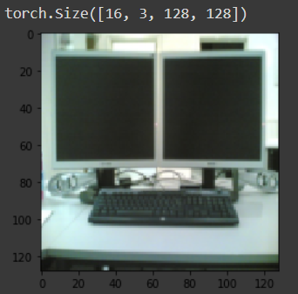


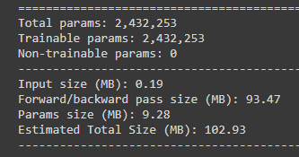
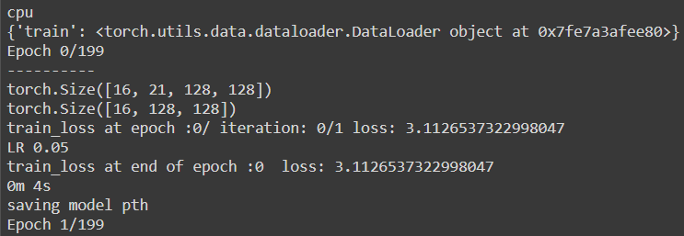
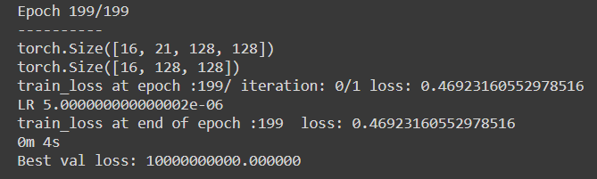
Experiment 1 – U-Net w/Batchnorm (24 ch)
● Result: overfitting
● Transforms: Resize(128,128), ToTensor()
● Only 16 pictures used
● Batch size: 16
● Epochs: 200
● Learning rate: 0.05
● Parameters:
● Training Loss Result:
Input
Target:
Output
Beginning::
Ending:

Slide 5
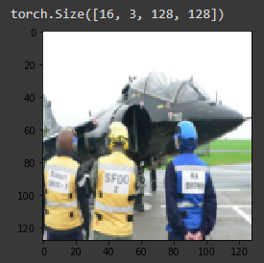


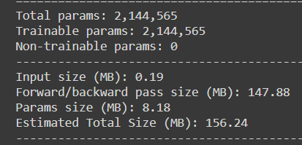
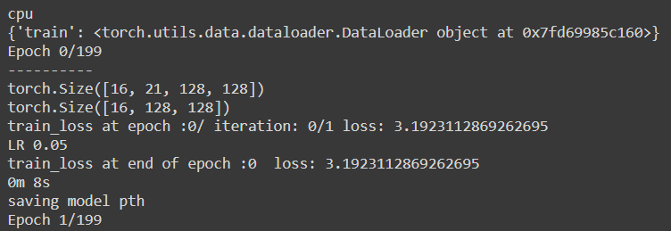
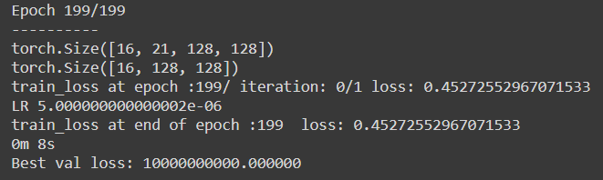
Experiment 2 – U-Net (32 ch)
● Result: overfitting
● Transforms: Resize(128,128), ToTensor()
● Only 16 pictures used
● Batch size: 16
● Epochs: 200
● Learning rate: 0.05
● Parameters:
● Training Loss Result:
Input
Target:
Output
Beginning::
Ending:

Slide 6
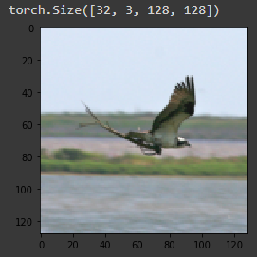

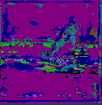
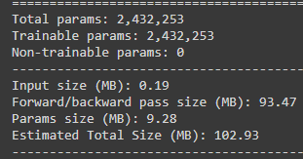
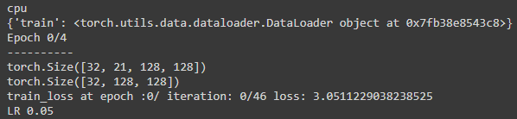

Experiment 3 – U-Net w/Batchnorm (24 ch)
● Result: underfitting
● Transforms: Resize(128,128), ToTensor()
● Whole training set used - 1464
● Batch size: 32
● Epochs: 5
● Learning rate: 0.05
● Parameters:
● Training Loss Result:
Input
Target:
Output
Beginning::
Ending:

Slide 7
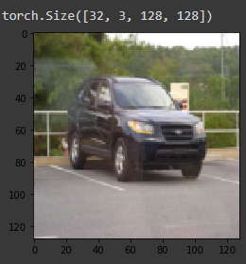

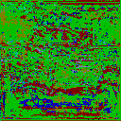
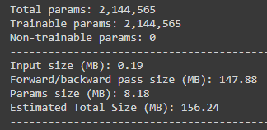
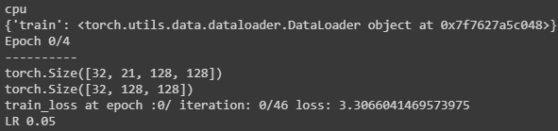

Experiment 4 – U-Net (32 ch)
● Result: underfitting
● Transforms: Resize(128,128), ToTensor()
● Whole training set used - 1464
● Batch size: 32
● Epochs: 5
● Learning rate: 0.05
● Parameters:
● Training Loss Result:
Input
Target:
Output
Beginning::
Ending:

Slide 8
Next steps:
● Dataset augmentation: horizontal flip, mirror
● Usage of different datasets: CityScapes, ADE20K, COCO Stuff
● Implementing different models: Deeplab V3+, FCN, SegNet, GCN, ENet

